Slide 1



Writing to servers with socket and closing server sockets
Nisha Bhattarai

Slide 2
Echo Server and Echo Protocol
The Echo Protocol, defined in RFC 862, is one of the simplest network protocols. It operates over TCP or UDP and is primarily used for testing network connectivity.
The server listens on port 7 (assigned by IANA).
The Echo Protocol is rarely used today because it can be exploited in Denial-of-Service (DoS) attacks, such as Smurf attacks.
An Echo Server is a type of server that simply receives data from a client and immediately sends it back without modification.

Slide 3
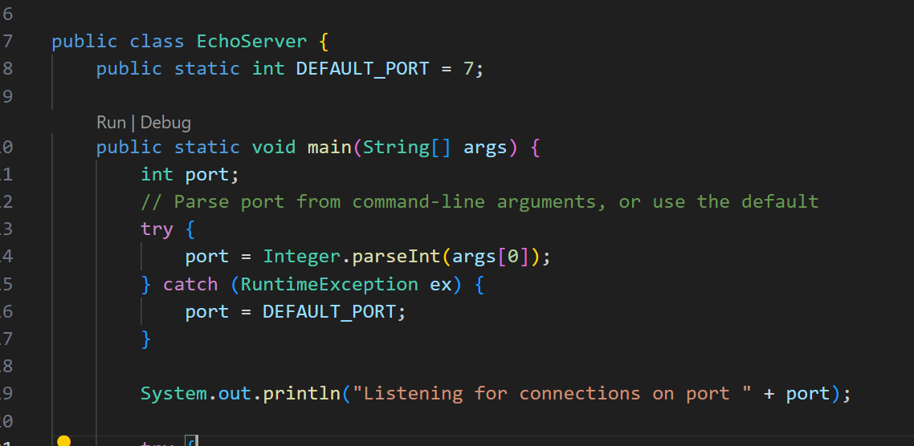
Code Description
If a port number is provided as a command-line argument, it is parsed.
If no port is given or an error occurs, the default port(7) is used.

Slide 4
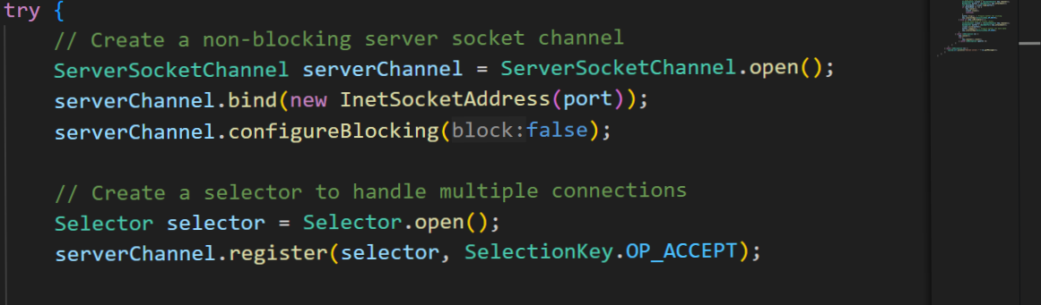
ServerSocketChannel is a non-blocking, selectable channel that allows a server to accept incoming TCP connections efficiently.
Selector is used to handle multiple connections.
Registers the ServerSocketChannel with the selector for OP_ACCEPT (listening for new connections).

Slide 5
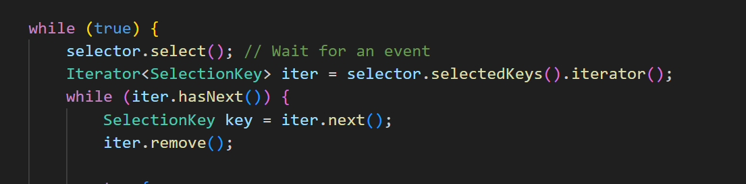
The server runs an infinite loop, continuously listening for events so selector.select() blocks until an event (connection, read, or write) occurs.
The Iterator loops through the ready keys(OP_connect ,OP_read ) and processes them.
Remove them so that we wont go back to that client again.

Slide 6
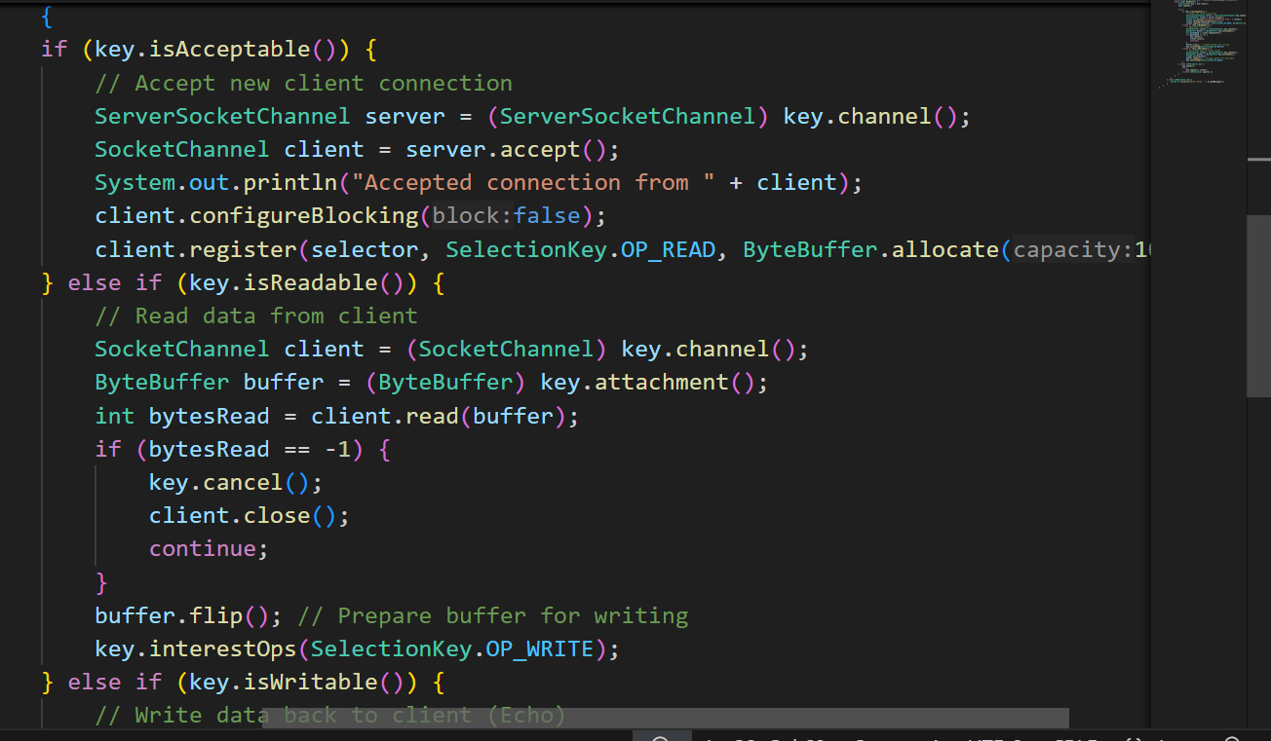
isAcceptable() is for accepting connections (server-side).
isWritable() is for writing data (outgoing operations).
isReadable() is for reading data (incoming operations).

Slide 7
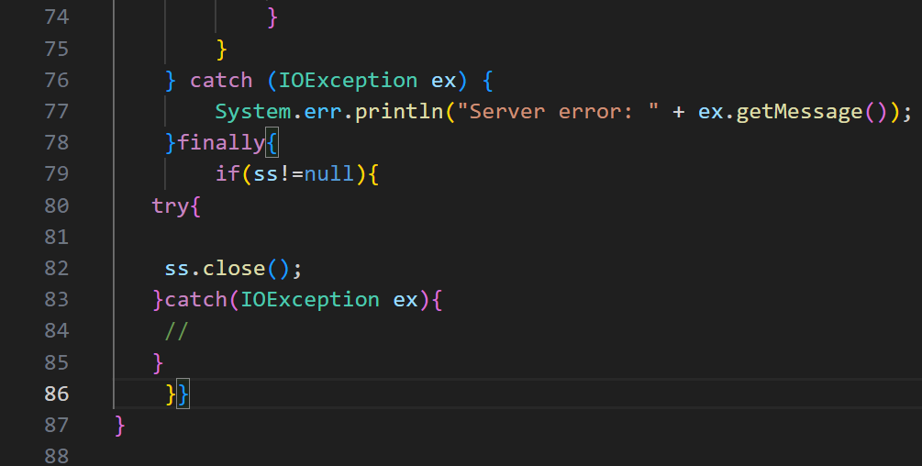
Closing server sockets
Why we need to close serversocket
Frees System Resources
Prevents Port Blocking: If a server socket is not closed properly, the OS keeps the port occupied for some time. This can prevent the server from restarting on the same port.
Ensures proper client handling.

Slide 8
Thank you

